Slide 1

FILEMIND
Intelligent File Access Prediction System
Operating Systems and System Programming — Review-2 / PBL-2
Project Team Members:
Shravya - 2510030123
Harshini - 2510030139
Anil - 2510030319
Deekshith - 2510030389

Slide 2
Literature Review: Intelligent File Access & Prefetching
Key research and technology areas that inform FileMind:
Approach | What it does | Main Limitation
Traditional Caching | Stores recently used files | No future prediction
Sequential Prefetching | Loads expected next files | Weak for irregular access
Pattern-Based Methods | Uses previous access patterns | Limited adaptability
ML-Based Prediction | Predicts future access | Requires historical data

Slide 3
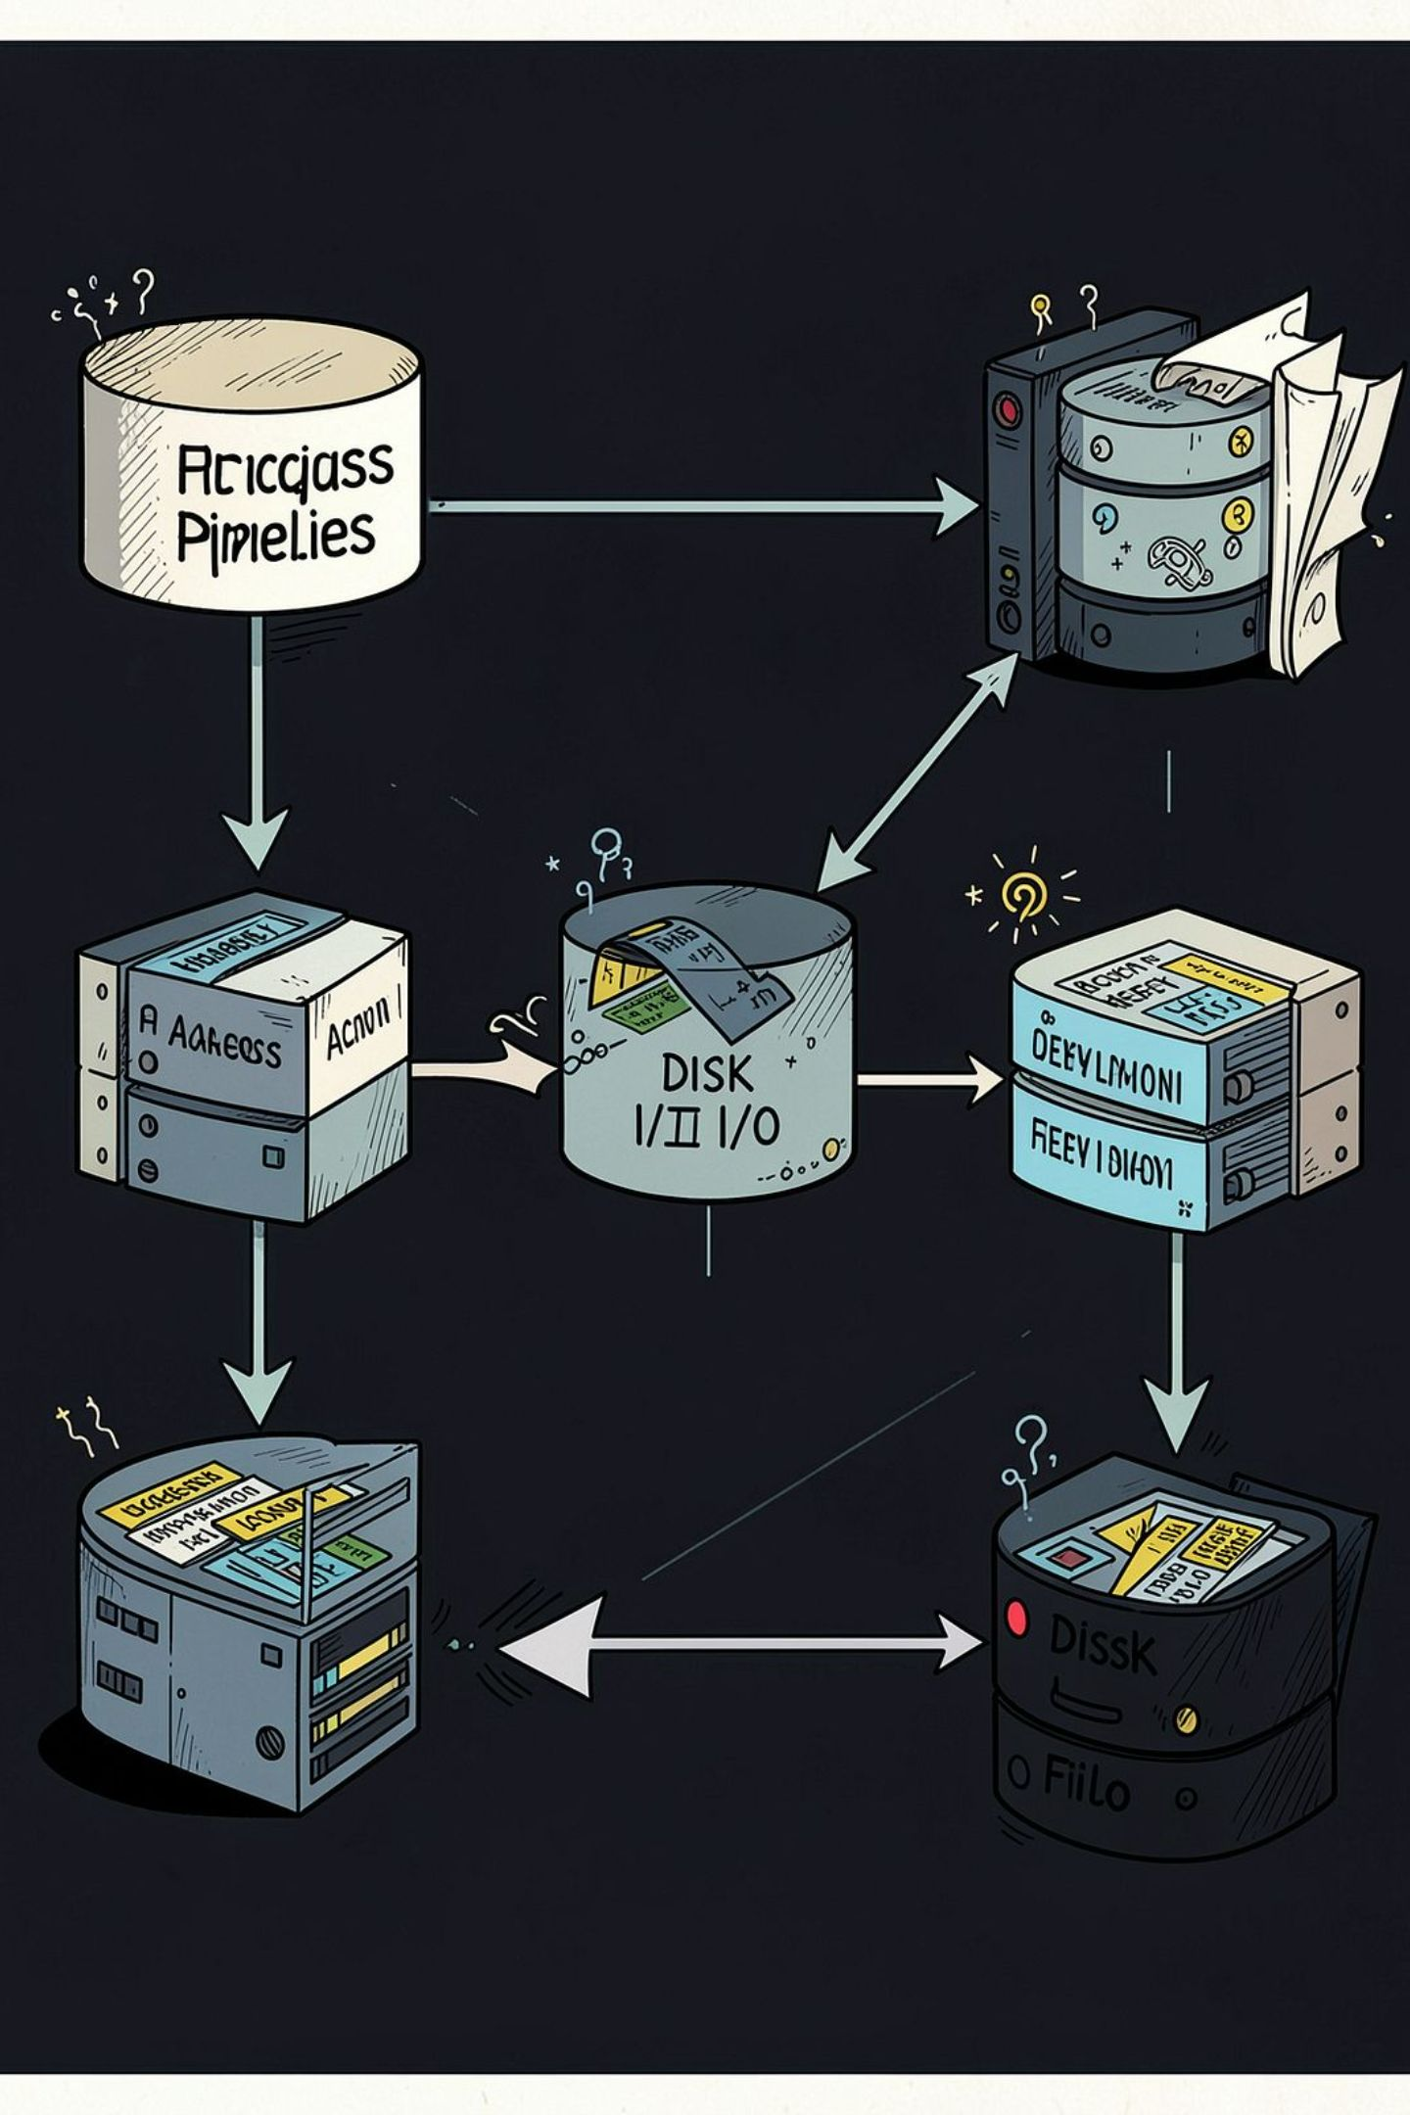
What Existing Systems Do — and Where They Stop
Typical file-access flow:
Strengths
Limitations
Simple implementation
Recently used files can be cached
Reduces repeated access in some cases
Prefetching can improve sequential access
Reactive rather than predictive
Does not learn individual user behaviour
Irregular access patterns are difficult to handle
Generic caching is not personalised
Disk access still occurs when required file is not prepared

Slide 4
Problem Statement
01 — Higher Access Time
02 — Unnecessary Disk I/O
03 — No User Behaviour Learning
04 — No Future Prediction
Files may require disk retrieval after the user requests them, causing latency.
Repeated file reads generate avoidable disk operations and wear.
The system does not anticipate which file will be required next.
Traditional systems do not learn individual file-access habits.
05 — Limited Optimisation
Generic caching does not adapt to individual usage patterns.
Traditional
FileMind
Request → Search → Access
Observe → Predict → Prepare → Access

Slide 5
Research Gap Identified
Existing systems:
Cache recently used files
Perform sequential prefetching
Analyse access patterns
Some approaches use prediction
GAP — Limited integration of:
Continuous file-access monitoring
Historical access analysis
Intelligent next-file prediction
OS-level prefetching
NEED: A proactive file-access system that predicts the user's next file and prepares it before the actual request.

Slide 6
Proposed Solution — FileMind
FileMind implements an end-to-end pipeline in five stages:
1. Access Monitoring
2. Access History
3. Pattern Analysis
Continuously track file-access activity via OS hooks and system-call tracing.
Build a time-stamped history of file usage for each user and session.
Identify meaningful and repeated sequences or temporal correlations.
4. ML Prediction
5. Intelligent Prefetching
Use lightweight machine-learning models to estimate the next-file probability.
Prefetch the predicted file into memory using OS-level prefetch mechanisms.
Flow: Monitor → Record → Analyse → Predict → Prefetch → Access

Slide 7

FileMind System Architecture
USER & OS
SYSTEM & HISTORY
Interaction between user and the operating system.
System programming accesses user's file history.
MACHINE LEARNING
PREFETCH & ACCESS
Applies algorithms to predict user needs.
Engine enables faster file access for efficiency.

Slide 8
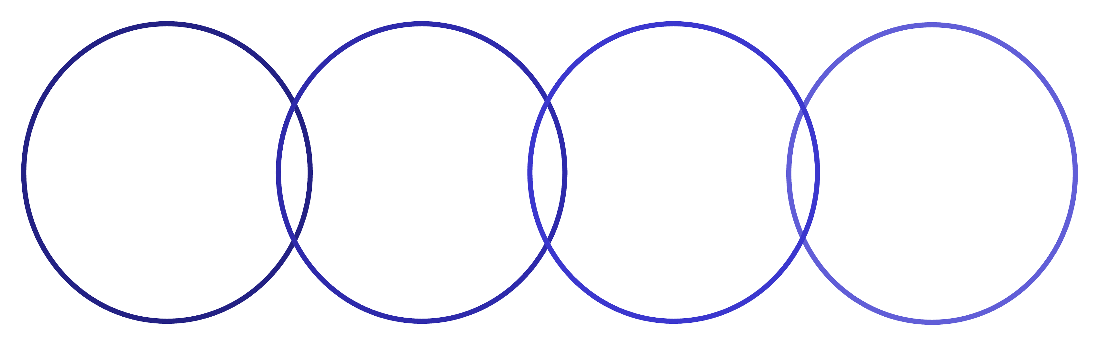
How FileMind Works — Data Flow
Initiate & Capture Access
Store & Analyse History
Predict & Prefetch File
Deliver Faster Access
Begin the process by capturing user access patterns.
Securely store and analyse historical access data.
Use analysis to predict and prefetch required files.
Provide accelerated access to prefetched content.

Slide 9
Implementation & Technology
Operating System
Machine Learning
Linux / Ubuntu
Python-based analysis
File System integration
File access event capture
Disk I/O coordination
NumPy
Pandas
Scikit-learn (lightweight models)
System Programming
Development Tools
C / C++ implementation
GCC
VS Code
Linux system calls
File handling and monitoring

Slide 10

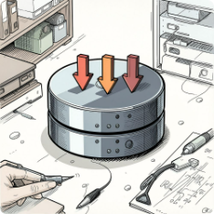
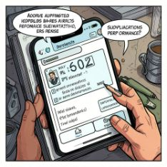

Expected Outcomes & Conclusion
Faster File Access
Reduced Disk I/O
Improved Responsiveness
Adaptive File Management
Prefetching predicted files reduces wait time when predictions are correct.
Preparing files in advance lowers repeated and redundant disk operations.
Historical behaviour refines predictions and adapts to individual users over time.
The system anticipates likely future requests to deliver quicker interactions.
Conclusion: FileMind transforms reactive file access into proactive file access by combining continuous monitoring, pattern analysis, prediction and OS-level prefetching.
FileMind
Predict. Prefetch. Perform.

Slide 11
THANK YOU!

